Slide 1
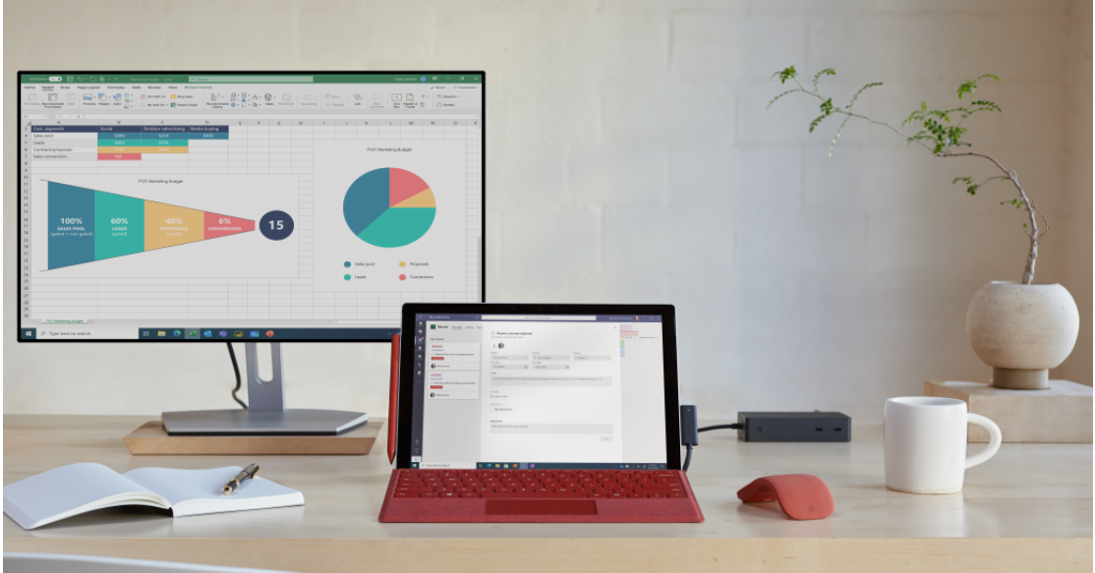
Partner Asset Guidance
Microsoft Surface Pro 7+ BOM
The Surface Pro 7+ digital demand gen assets are intended to highlight the value and features of Microsoft Surface Pro 7+ in a quick, easy-to-digest way with the call to action for the reader to learn more.
The Surface Pro 7+ digital demand gen assets include email templates, a digital flyer, digital web banners and five (5) social media assets.
Introducing the Surface Pro 7+ Email Templates
Format: OFT and HTML
How to edit: Use a Microsoft Office-compatible program (Microsoft Outlook) to add your logo and hyperlink the call to action.
2. Surface Pro 7+ Digital flyer
Format: PDF
How to edit : Use Acrobat Adobe to add your partner logo and then export to PDF.
3. Surface Pro 7+ Web banners
Format PSD sizes 300x250 and 728x90
How to edit: These assets will need to be edited in a tool like Adobe After Effects.
Instructions for how to use the demand gen assets
4. Surface Pro 7+ Social Assets
Announce: Intended to be used to announce the product. Add the approved CTA copy and link to the blog post announcing the news, or local product page.
Built for business: Describes how Surface Pro 7+ is Built for business
Ready for anything: Highlights features that make Surface Pro 7+ Ready for anything
“Inking”: Highlights key features that makes Surface Pro 7+ a device that can keep up.
LinkedIn Story: Highlights key features that makes Surface Pro 7+ a device that can keep up.
Social format and editing tips:
Format: AI, PSD, XD, PNG, and MP4
Editing tips: Digital social assets will need to be edited in a tool like Adobe After Effects.
Note: Use image copy provided when posting to social media
© 2020 Microsoft Corporation. All rights reserved. This document is provided “as-is.” Information and views expressed in this document, including URL and other Internet Web site references, may change without notice. You bear the risk of using it.

Slide 2
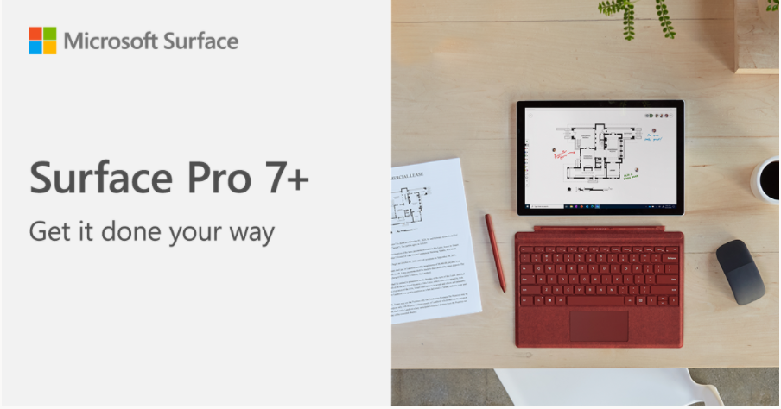
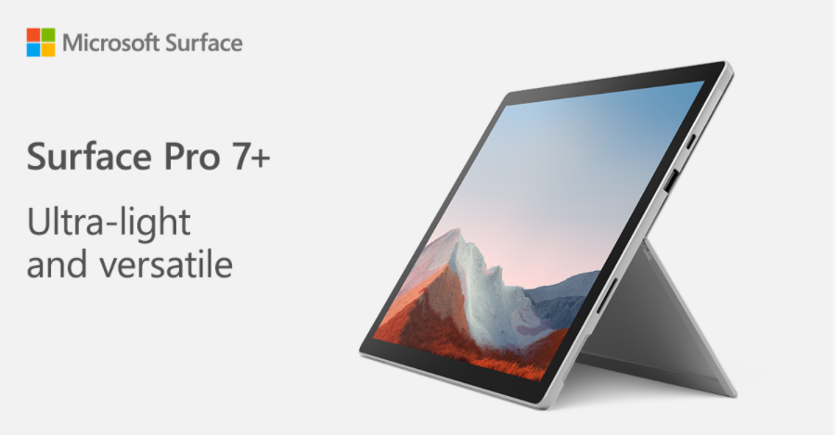
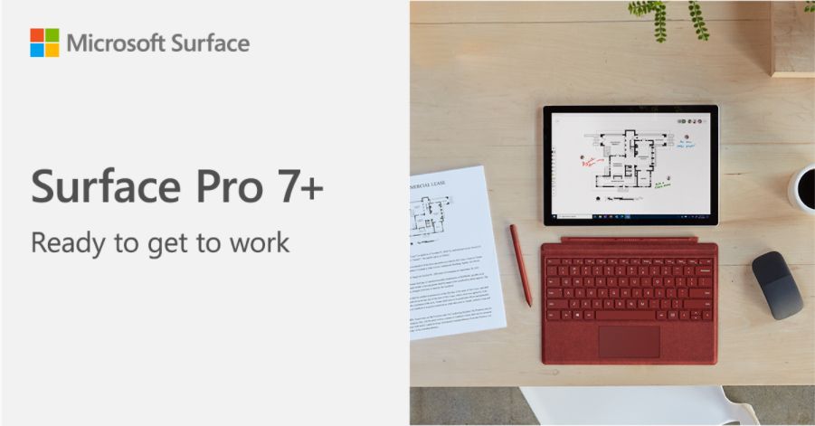
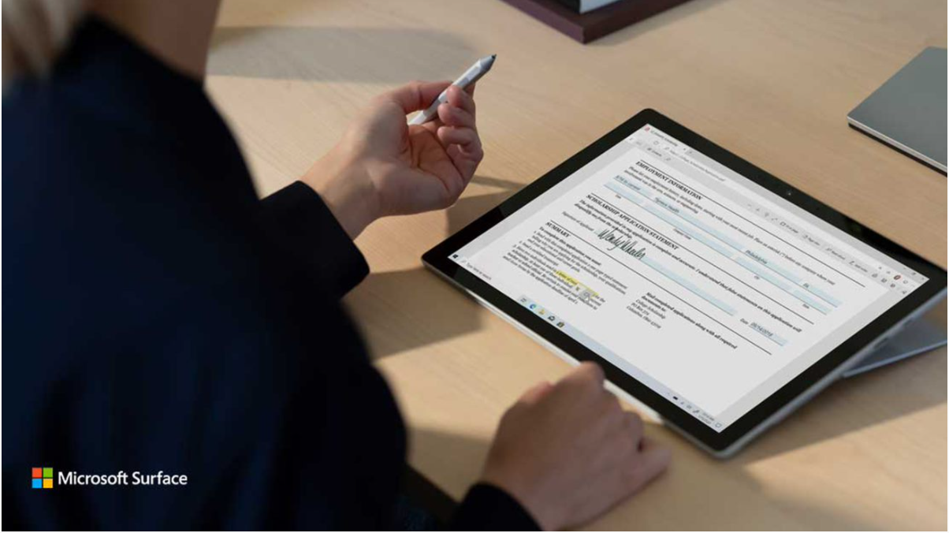
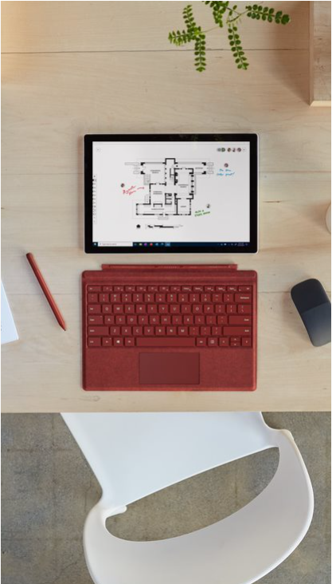
Instructions for how to build your social post
All social posts were built for use on the LinkedIn platform. Animated social posts can also be leveraged for use on owned and operated (O&O) LinkedIn, Facebook, and Twitter handles given that they have similar spec requirements. When posting to O&O social media channels, use the copy below that corresponds to the approved imagery For this launch, there are five (5) posts:
_{Asset Location + Title} | _{Thumbnail} | _{File type} | _{Post copy} | _{CTA}
01. Announce folder: Surface_Pro7+_Announce_Static |  | PNG | Introducing the new Surface Pro 7+. Stay connected with optional LTE Advanced and do it your way with our ultra-light 2-in-1. #SurfaceForBusiness | Introducing the new Surface Pro 7+ for Business
02. Built for Business folder: Surface_Pro7+_Built_Static Surface_Pro7+Built_Animated |  | PNG MP4 Source files | Surface Pro 7+ unlocks value for your business with a removable hard drive, accessories that work across generations, and more. #SurfaceForBusiness | Meet the new Surface Pro 7+ for Business
03. Ready for Anything folder: Surface_Pro7+_Ready_Static |  | PNG​ | Get intensive tasks done and get them done faster than before—Surface Pro 7+ powers the software and business apps you depend on. #SurfaceForBusiness ​ | Meet the new Surface Pro 7+ for Business
04. Inking folder: Surface_Pro7+_Animated_Social_MP4 |  | MP4 Source files | Wherever and however you work, Surface Pro 7+ helps you get the job done by transforming from everyday laptop, to powerful tablet, to portable studio. | Learn more about Surface Pro 7+
05. LinkedIn Story folder: Surface_Pro7+Social_LinkedInStory_SourceFile |  | MP4 Source files | Get a device that can keep up. Tablet mode. Studio mode. Laptop mode. Now with LTE Advanced. Surface Pro 7+ | Learn more about Surface Pro 7+

Slide 3
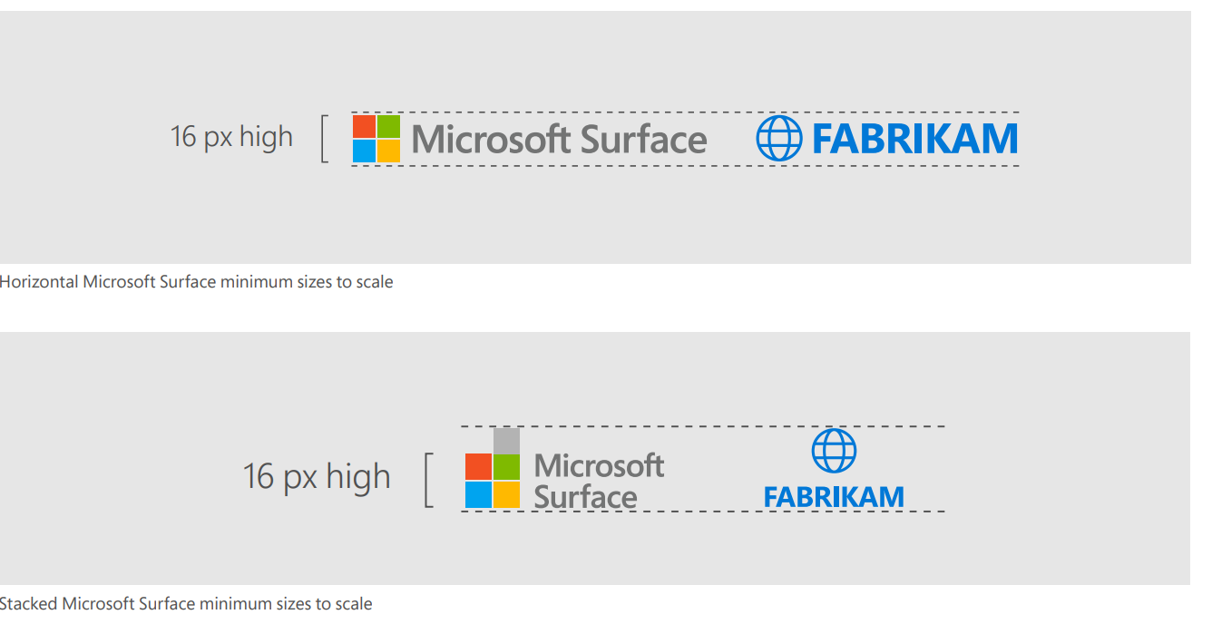
Instructions on co-branding Microsoft Surface assets
Partner logo can be added to the bottom left corner of the asset using the guidelines below.
Horizontal logo: Partner logo should be no less than 16 px high and should not exceed more than the height of the horizontal Microsoft Surface logo.
Stacked logo: Partner logo should be no less than 16 px high and should not exceed more than 1 symbol square higher than the stacked Microsoft Surface logo.
Padding on all banners following the horizontal logo rules at 16 px.

Slide 4
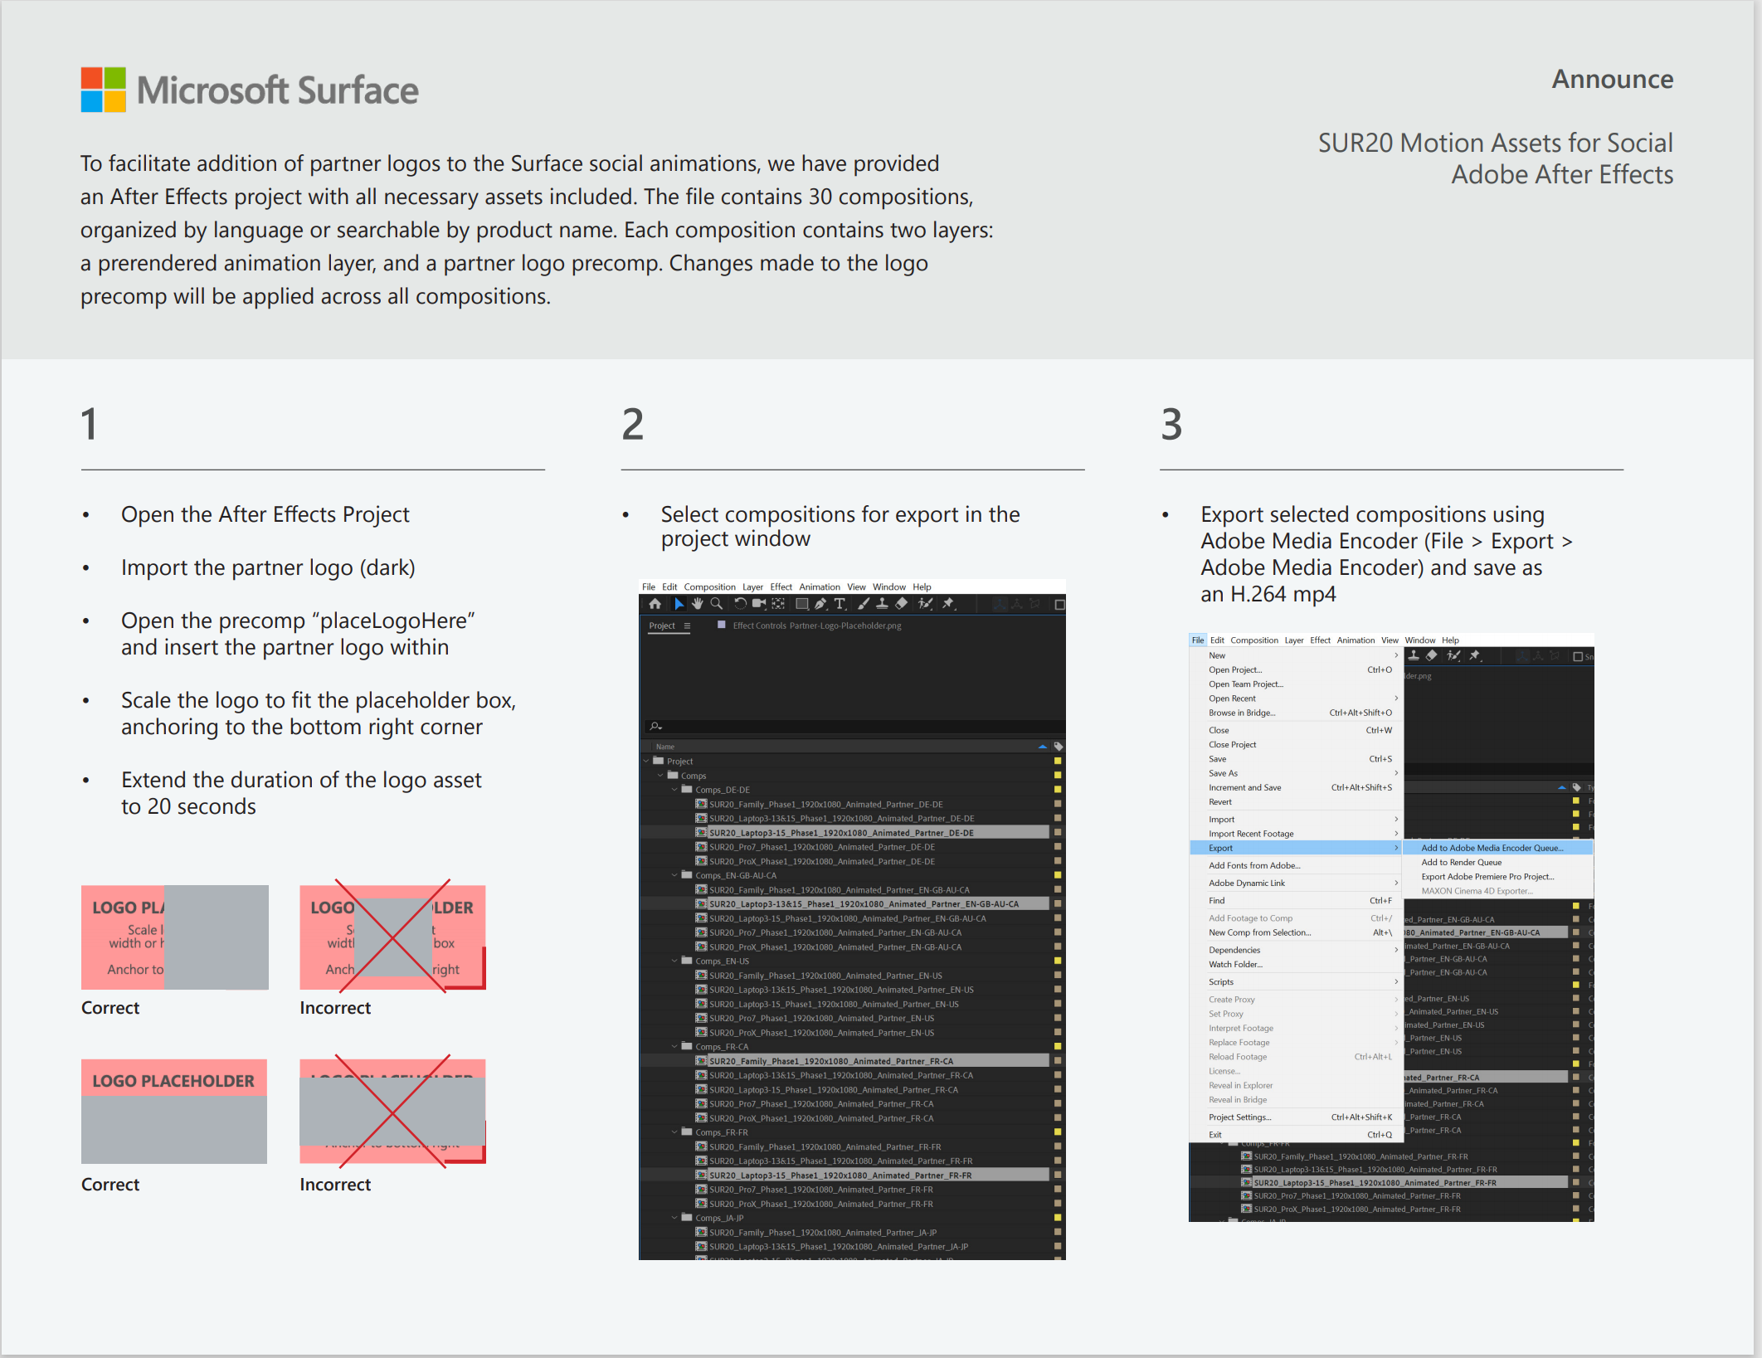
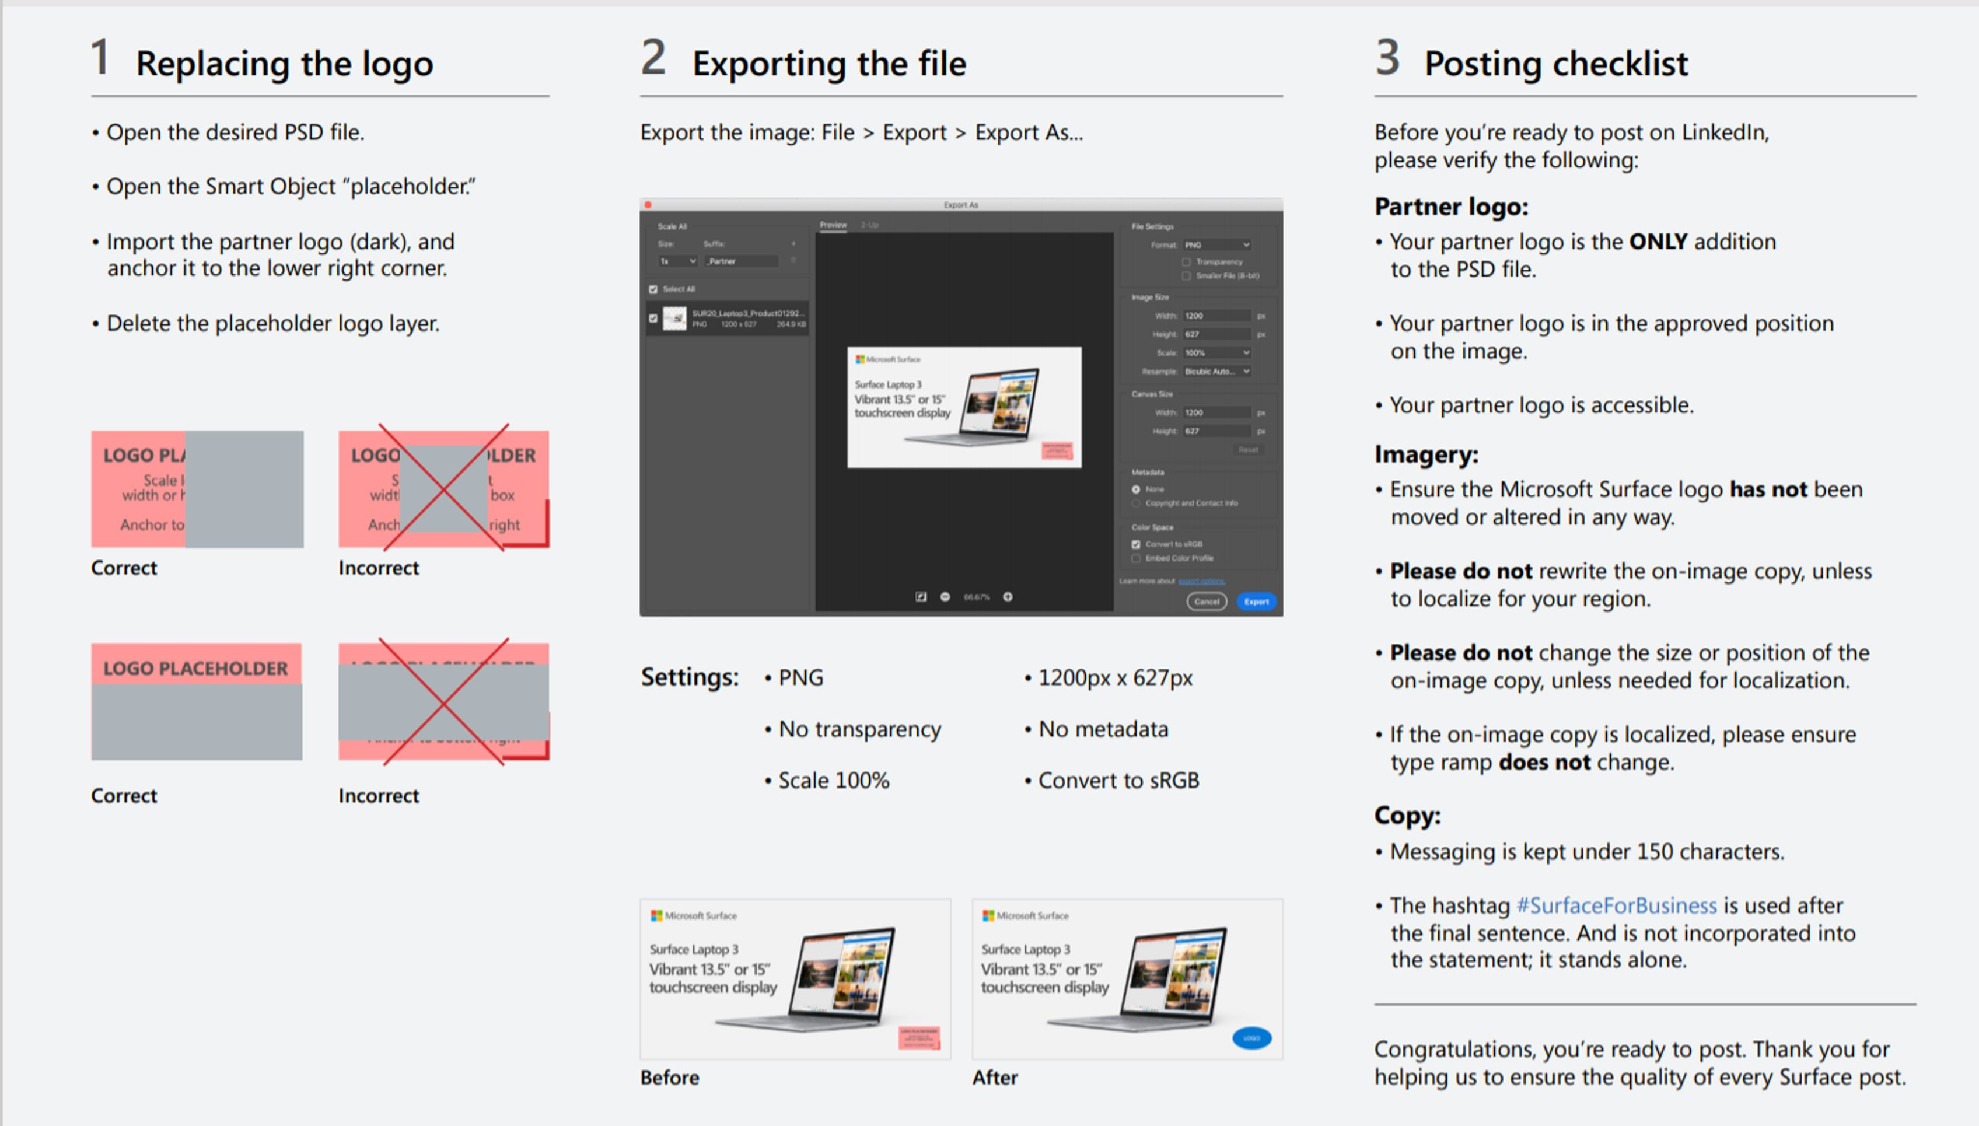
Instructions on how to add your partner logo to social posts
Figure 1: Add logo to animation files. *Requires the use of Adobe After Effects
Figure 2: Add logo to static files.
Figure 1: Animation
Figure 2: Static

Slide 5
Microsoft Surface Video Guidance
These guidelines are intended for Surface Partners when using videos to market Microsoft Surface products.
1 Video Usage
Microsoft Surface videos must be used as is with no changes to color, proportion, text, design, or sound. The video may be trimmed or split to reduce the length.​
2 End Cards
If approved by your MSFT FTE, a partner logo can be added to the video as its own end card that directly follows the Microsoft Surface end card, using the same transition effect.
Image of Microsoft Surface end card
Example of Partner end card

